Slide 1
Broadcast Technology UG1
1: Introduction; The Industry
Jerry Foss
jeremy.foss@bcu.ac.uk

Slide 2
Schedule for the Module
Learning Outcomes
1. Differentiate between TV audio and video standards and apply for studio applications
2. Evaluate and select data interconnects for audio and video
3. Select and apply test procedures for audio and video signals
4. Compare and contrast network transmission standards worldwide, current and legacy, and evaluate for application to broadcast developments

Slide 3
SCHEDULE (Planned)
APRIL
19 | am |  | Introduction, Markets, Developments | Transmission Media
19 | pm |  | Electrics, Shielding, Connectors | Tutorial 1 - Freq, wavelength, period, bandwidth
20 | pm |  | Signals | Tutorial 2 - cables, conductors
MAY
6 | am |  | Modulation, Multiplexing | Tutorial 3 - Signals, Transmission
6 | pm |  | The Legacy of Analogue | Lighting and Control
7 | am |  | TV Standards, Colour Space | Tutorial 4 - Modulation
17 | am MD |  | Video Signals, Measurements
17 | pm MD |  | Video Signals, Measurements
20 | am |  | Gamma, OOTF, PQ | Tutorial 5 - Signals 2
20 | pm
21 | am |  | Group Presentations - preparation
JUNE
9 | am |  | Group Presentations - presentations | Tutorial 6 - General Knowledge
10 | am |  | Packet Media, Compression, Workflow and MPEG Systems | Tutorial 7 - Video signal test
10 | pm |  | Contribution and Distribution | Tutorial 8 - Test questions
11 | am |  | Broadcast Workflow
14 | am | exam | Submission online Thursday 14th,12 noon

Slide 4
Assessment
Duration (+ read time): | Time allowed for the assignment: 3 days (75 hours to hand-in deadline) The nominal time expected for the assessment work is approximately 10 hours
Word Count | 3000 (excluding tables, illustrations and references)
Total number of questions: | One question
Marks: | 100 marks total
What will be provided by the examiner: | The exam is open-book
Non-standard items that candidates may bring in to the exam room: | n/a
Assignment:
You are to research and present a report on the subject given on the exam paper

Slide 5
Assessment
Assessment Criteria: | 1. Collect relevant information | 2. Demonstrate assimilation of information | 3. Written report
Weighting: | 30% | 40% | 30%
Grading Criteria 0 – 29% | Little evidence of relevant information | No evidence of analysis. | Unacceptable in terms of style, language & referencing. No bibliography. No diagrams.
30 – 39% | Over-reliance on one source (e.g. a company’s web site, lecture slides, Wikipedia page or similar) | Little evidence of analysis. Report reiterates information gathered from minimal sources | Major deficiencies in style and language. Questionable attribution of sources. Limited use of diagrams.
40 – 49% | Some relevant research but lacking in extent and level | Weak analysis of information. Lacking any obvious consideration | Significant shortcomings in style and language. Attempts at attribution of sources.
50 – 59% | Broad research but not all relevant to the assignment brief | Generally competent analysis but lacking in any real depth | Style and language generally clear. Some minor errors. All sources referenced. Relevant diagrams.
60 – 69% | Wide ranging research, demonstrating methodological approach. | Comprehensive analysis of data leading to logical conclusions | No major shortcomings in style and language. Appropriate referencing. Well structured. Good use of diagrams.
70 – 90 % | Extensive research demonstrating breadth of information required. | Critical analysis of information demonstrating ability to crystallise key issues | Clear, logical and error-free. Comprehensive bibliography. All sources appropriately referenced.
>90% | All criteria would near professional quality with clear application to the report

Slide 6
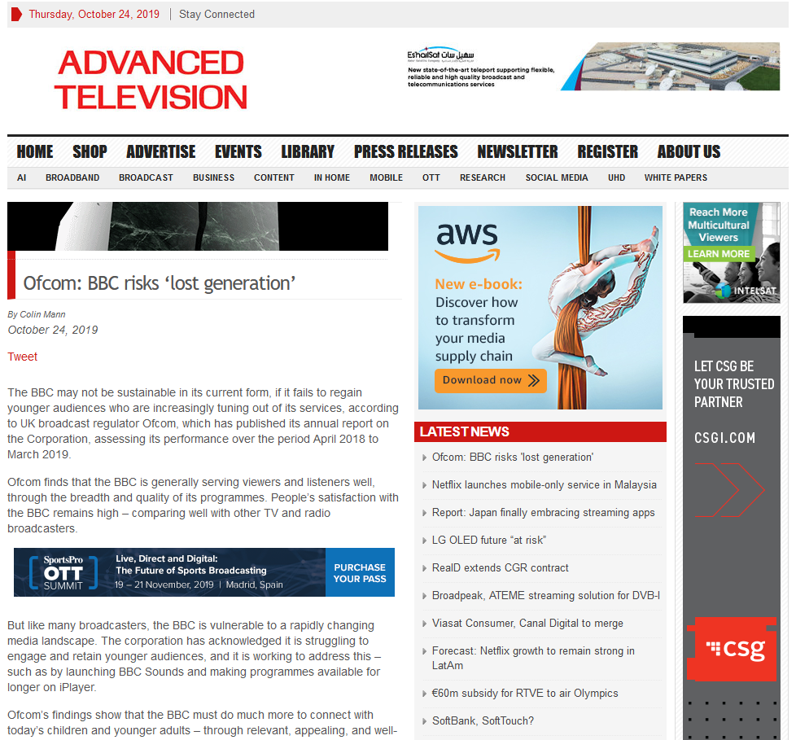
https://advanced-television.com/2019/10/24/ofcom-bbc-risks-lost-generation/
The BBC may not be sustainable in its current form, if it fails to regain younger audiences who are increasingly tuning out of its services, according to UK broadcast regulator Ofcom …
… like many broadcasters, the BBC is vulnerable to a rapidly changing media landscape.
… acknowledged it is struggling to engage and retain younger audiences
… working to address this
… BBC Sounds
… programmes available for
longer on Player

Slide 7
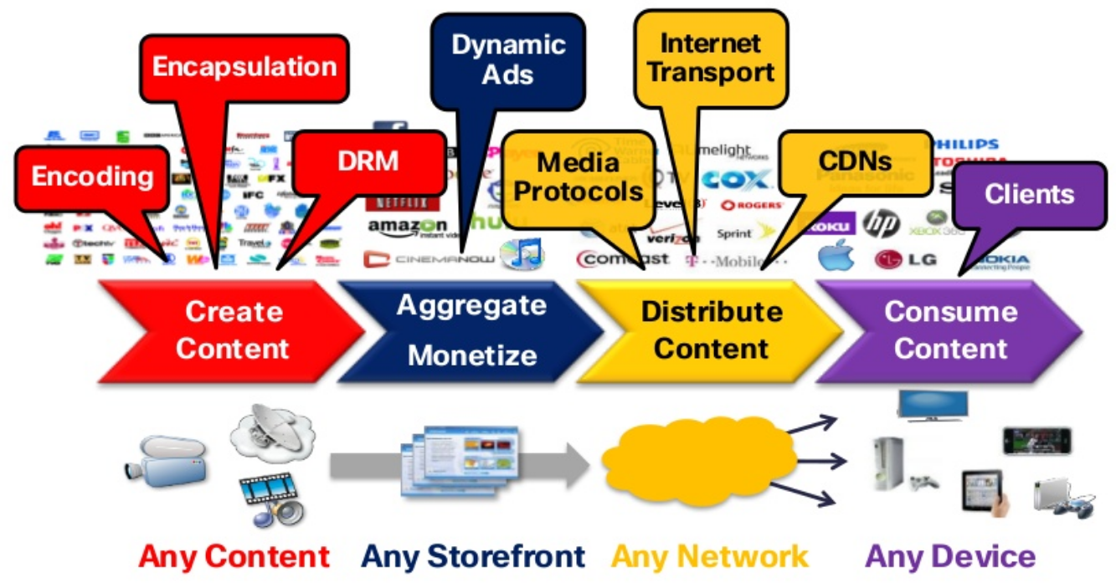
Open Digital Media Value Chain
Contribution, production
Distribution, consumption
Slide – Christian Timmerer, bitmovin, Alpen-Adria-Universität

Slide 8
Open Digital Media Value Chain

Slide 9
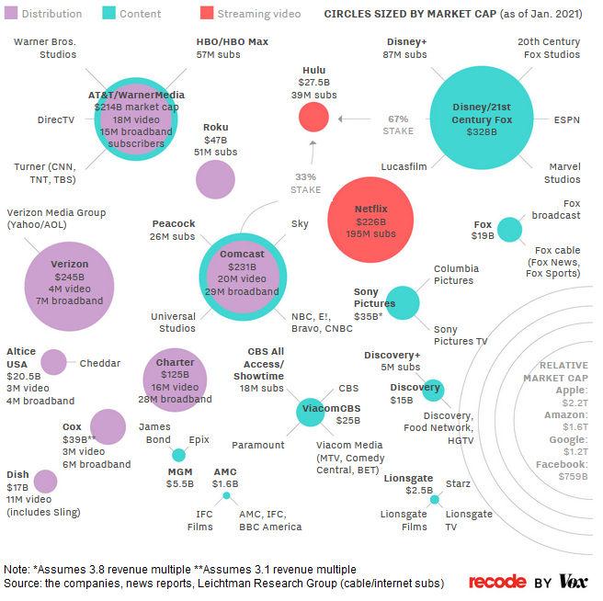
Media Landscape
Used to be straightforward:
Content companies - studios
… made shows, movies
… sold it to distributors
… who sold it to consumers
Now
Netflix buys from studios
… also makes own stuff
… sell directly to consumers
Traditional media companies
… compete by consolidating
… Disney purchase of 21st Century Fox
… Distributors - AT&T
… bought Time Warner last year
… becoming media companies, too
giant tech - Google, Amazon, Apple
… becoming media companies
… Apple now position as
… a TV guide / storefront
sell services like HBO
… a TV creator
exclusive shows for Apple users
https://www.vox.com/2018/1/23/16905844/media-landscape-verizon-amazon-comcast-disney-fox-relationships-chart

Slide 10
From IBC 2019
[IBC at Harmonic Inc]
A lot of rights owners simply do not have the experience, technical know-how, budget or time to bring content through a D2C streaming service
- Steve Russel, Red Bee Media
Move to SaaS based offerings - cloud solutions up to 8K, - Harmonic Inc
D2C
Direct to Customer

Slide 11
From DVBWorld 2019 – Targetted Advertising
TA - Targeted Advertising
US internet advertising has now exceeded TV advertising
Re-balance with TA?
Vincent Grivet, VP, Broadcast Develoment at TDF Group
TA: need to enhance the user experience for TA to be commercial success
e.g. - by reducing advertising time; removing un-needed ads - Les Carter, VP and chief architect, Cadent Technologies

Slide 12
From DVBWorld – Streaming and Coding
LL DASH
Low Latency DASH
@DVB_Project delivered LL DASH on time
- Thomas Stockhammer, Qualcomm
Latest developments in video codecs - VVC outperforms both HEVC & AV1 by 30%.
VVC work completed 2020
- Marta Mrak, BBCR&D
8K - A visionary step forward or an unnecessary illusion?'
Delegates asked to vote twice - "Will 8K be an important TV delivery format in the future?"
First poll: 66% No
Second poll: 80% No
- David Wood @EBU_Tech

Slide 13
From DVBWorld 2019 – Streaming and Coding
Adaptive Bitrate Streaming over Multicast -
' Multicast delivery could be a key tech convergence point between broadcast and mobile network ecosystems.’
- Paul Szucs, Sony
Adaptive Streaming – best for efficiency and image quality = CMAF + H264
(Ignoring legacy and interoperability issues)
CMAF Common Media Application Format - has features beyond DASH
DVB-I - enable broadcasters and network operators to offer OTT to both TV and IP-only connected devices - DVB Project

Slide 14
From DVBWorld 2019 – 5G
Is there enough RF spectrum for broadcast & 5G broadcasting?
Direct broadcast to mobile devices failed.
Why should 5G be any different?
Can 5G replace DVB-T2?
- Panel discussion
'Broadcasters will adopt 5G when and where it brings real benefits to their business. It will be a complement rather than a substitute for existing technologies.’
- Darko Ratkaj, EBU
5G - What can it deliver? Enhanced mobile broadband, Massive IoT Ultra reliable & low latency comms
- Erik Guttman, 3GPPLive
eMBMS deployments may not happen
but 5G will offer a multi-layer system
LTE-based FeMBMS (Further Evolved Multimedia Broadcast Multicast Systems) may have a 5G label
- Stefan Ilsen, Institut für Nachrichtentechnik

Slide 15
From DVBWorld – AR, VR; Security
AR - significant role in TV - Thomas Stockhammer, Qualcomm
Is there a future for VR?
Forensic Watermarking added to content; trace origin
trade off between robustness and visibility - Laurent Piron, Nagra
Watermarking and compression
Smart Contracts on DLTs (Blockchain)

Slide 16
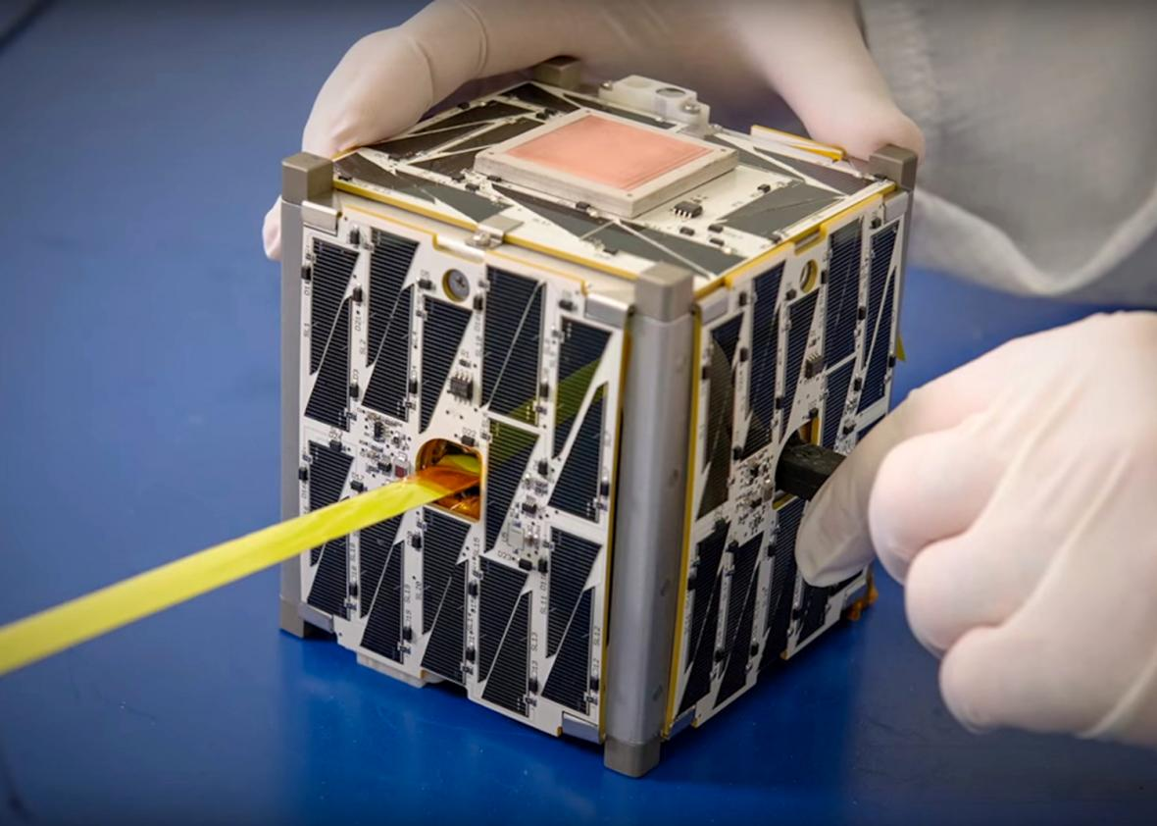
From DVBWorld - Satellites
Satellite Technologies
need more capacity, more flexibility
finding new markets are key
Next generation satellites - programmable beams, electrical propulsion (much lighter)
Other frontiers are cubesats and nanosats.
Cubesats

Slide 17
From DVBWorld – HbbTV
HbbTV - national variations in the systems, but also much commonality
Growing use in IPTV networks. Latest version 2.0.2
- Jon Piesing, Director, Standardisation at TP Vision
adaptive streaming is key in Hbb
Adaptive Systems are now included in HbbTV 1.5 and beyond.
Cubesats

Slide 18
TV/Online Sports
OTT becoming a dominant way of delivering sport
Marina Kalkanis, M2A Media
But latency is an issue.
“.. there’s no doubt that broadcast latency is better than online latency"
>70% EE traffic is video
The most well defined use case for 5G is for remote production outside broadcast
Massive usage spike on mobile networks during big football matches, known as 'the football curve’

Slide 19
TV/Online Sports
4K expensive for mobile - Matt Stagg, EE.
The optimum for mobile is HD with HDR
Industry is not seeing great deal of demand for 4K. Uptake is fairly limited
Panel discussion
WCG and HDR knocks spots off anything that extra pixels does
Shane Warden, ATP Media

Slide 20
TV/Online Sports
The clips business
one of the fastest rising parts of the sports video industry thanks to rise of Facebook etc (!!) .. a market that barely existed a few years ago
Phenomenal rise of eSports
developing similar to traditional sport with leagues, franchises etc. 'eSports is a really good fit for VR,"
Gareth Capon, Grabyo
AI increasing - create automatic 2 or 3 min compilation clips in sport, picking out goals, red cards etc - can then be sent to production staff to review
Deon Cortgrove, Timeline
most AI engines process in the cloud, but - cost and security concerns
Jason Coari, Quantum

